Slide 1
Welcome to GVSETS 2026
Autonomy & Robotics
Oleg Sapunkov, Ph.D.

Slide 2
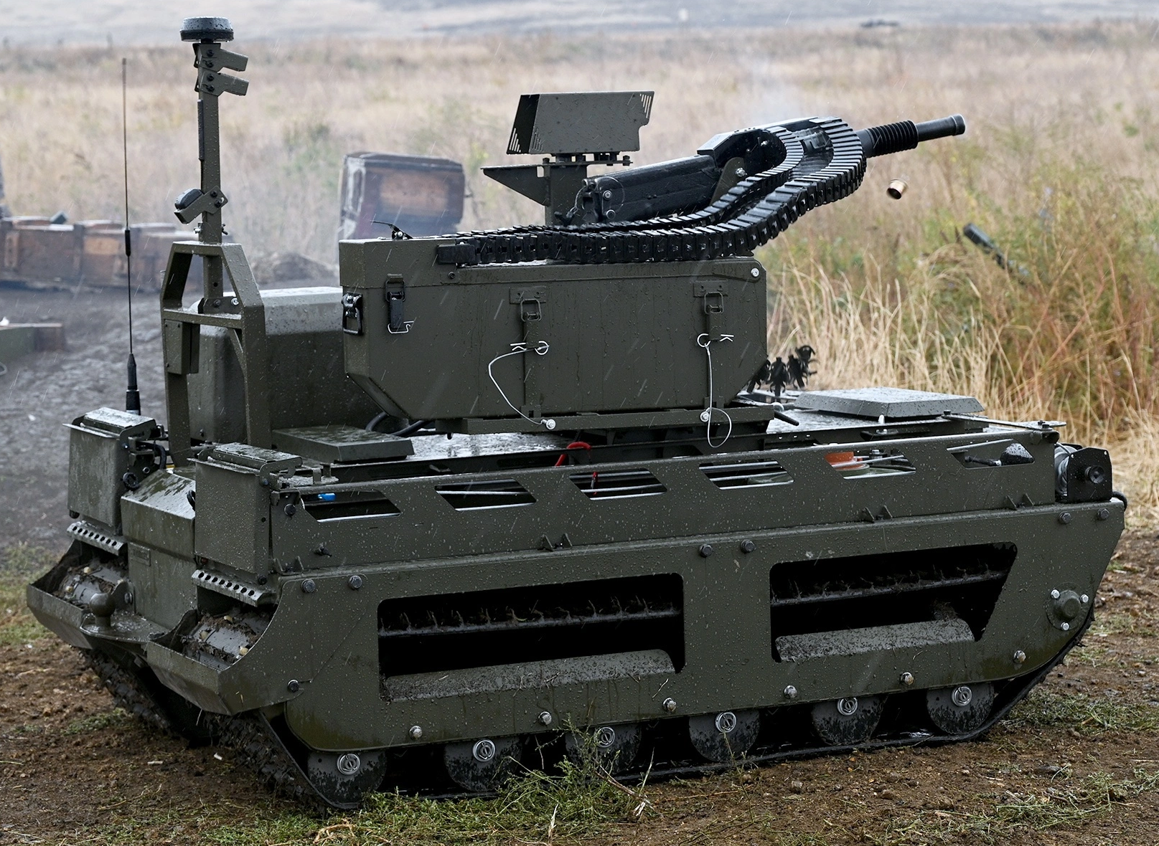
Welcome to GVSETS 2026
A few sobering combat statistics from the Russia / Ukraine War
10 000 UAV missions per day
10 000 UGV missions per month
3/4 casualties via robot

Slide 3
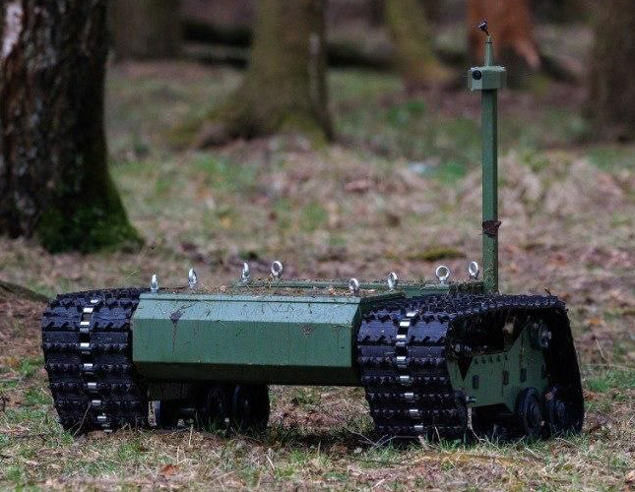
Welcome to GVSETS 2026
UGV mission set:
Reconnaissance
Casualty Evacuation
Resupply
Kamikaze
Direct Fire
Indirect Fire
Mine / Obstacle Laying
Mine / Obstacle Clearing
Bridging
Electronic Warfare
Directed Energy
Drone Mothership
Drone Interceptor
Combat Engineering

Slide 4
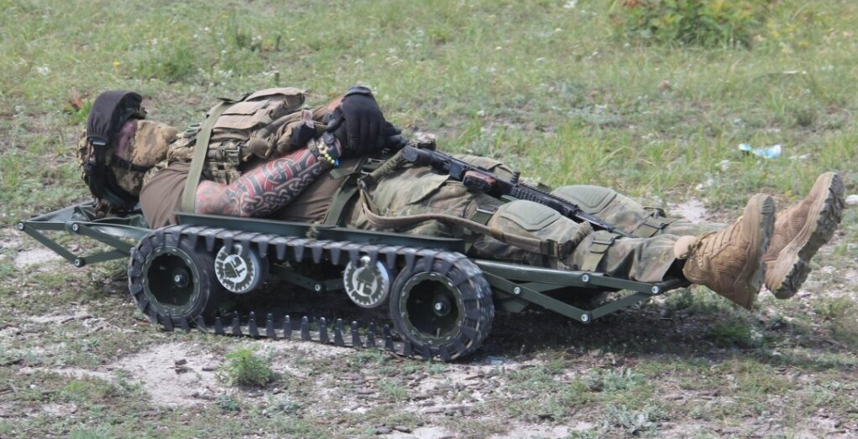
Welcome to GVSETS 2026
UGV mission set:
Reconnaissance
Casualty Evacuation
Resupply
Kamikaze
Direct Fire
Indirect Fire
Mine / Obstacle Laying
Mine / Obstacle Clearing
Bridging
Electronic Warfare
Directed Energy
Drone Mothership
Drone Interceptor
Combat Engineering

Slide 5
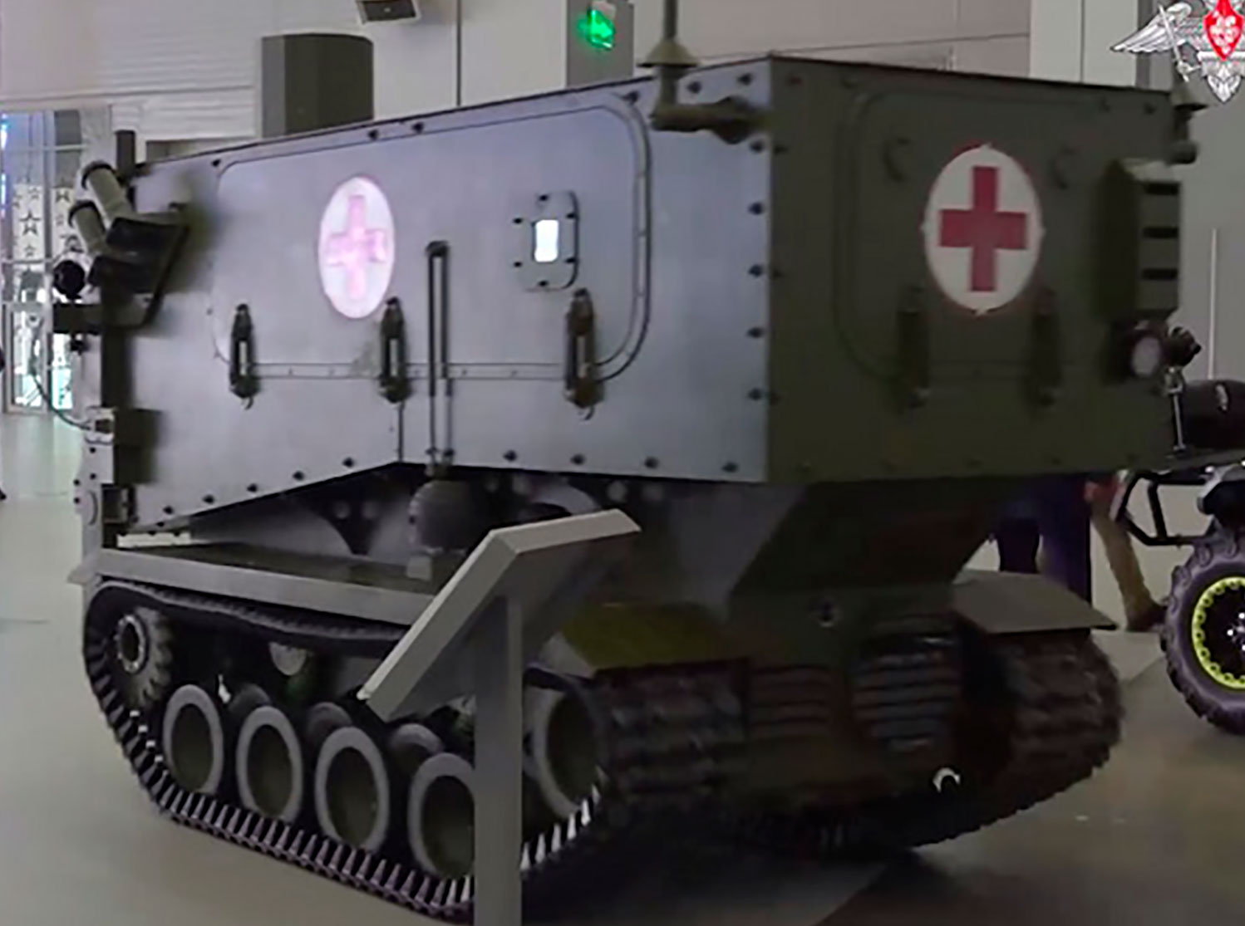
Welcome to GVSETS 2026
UGV mission set:
Reconnaissance
Casualty Evacuation
Resupply
Kamikaze
Direct Fire
Indirect Fire
Mine / Obstacle Laying
Mine / Obstacle Clearing
Bridging
Electronic Warfare
Directed Energy
Drone Mothership
Drone Interceptor
Combat Engineering

Slide 6
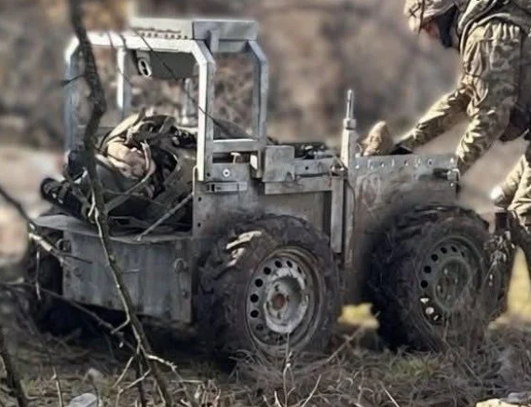
Welcome to GVSETS 2026
UGV mission set:
Reconnaissance
Casualty Evacuation
Resupply
Kamikaze
Direct Fire
Indirect Fire
Mine / Obstacle Laying
Mine / Obstacle Clearing
Bridging
Electronic Warfare
Directed Energy
Drone Mothership
Drone Interceptor
Combat Engineering

Slide 7
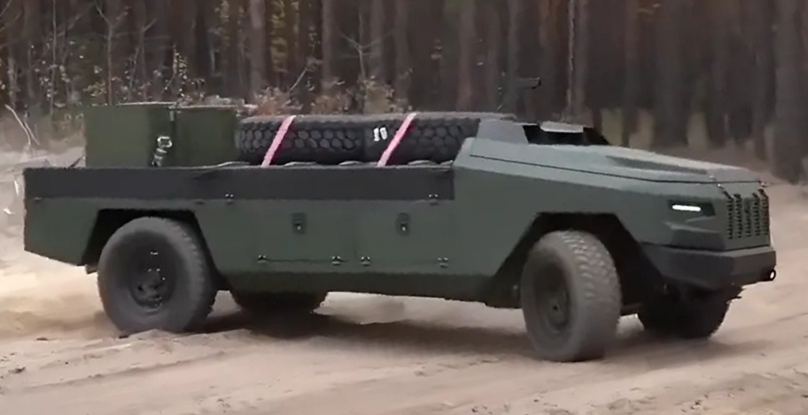
Welcome to GVSETS 2026
UGV mission set:
Reconnaissance
Casualty Evacuation
Resupply
Kamikaze
Direct Fire
Indirect Fire
Mine / Obstacle Laying
Mine / Obstacle Clearing
Bridging
Electronic Warfare
Directed Energy
Drone Mothership
Drone Interceptor
Combat Engineering

Slide 8
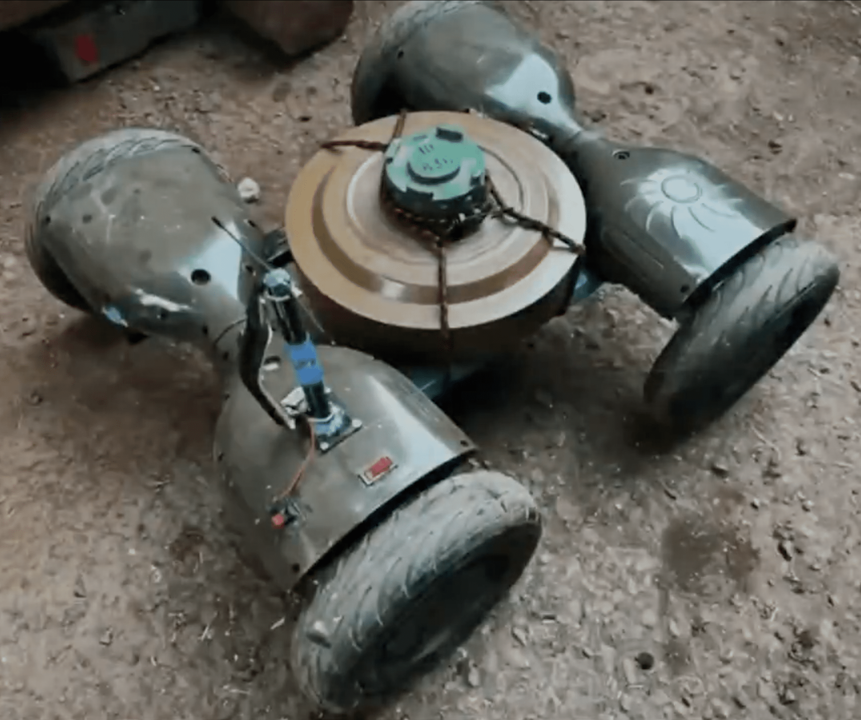
Welcome to GVSETS 2026
UGV mission set:
Reconnaissance
Casualty Evacuation
Resupply
Kamikaze
Direct Fire
Indirect Fire
Mine / Obstacle Laying
Mine / Obstacle Clearing
Bridging
Electronic Warfare
Directed Energy
Drone Mothership
Drone Interceptor
Combat Engineering

Slide 9
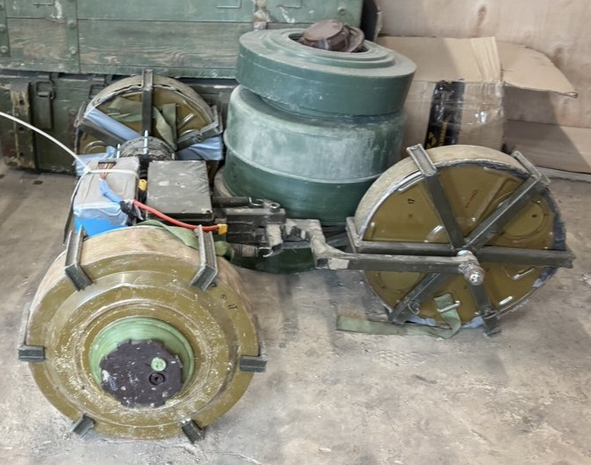
Welcome to GVSETS 2026
UGV mission set:
Reconnaissance
Casualty Evacuation
Resupply
Kamikaze
Direct Fire
Indirect Fire
Mine / Obstacle Laying
Mine / Obstacle Clearing
Bridging
Electronic Warfare
Directed Energy
Drone Mothership
Drone Interceptor
Combat Engineering

Slide 10
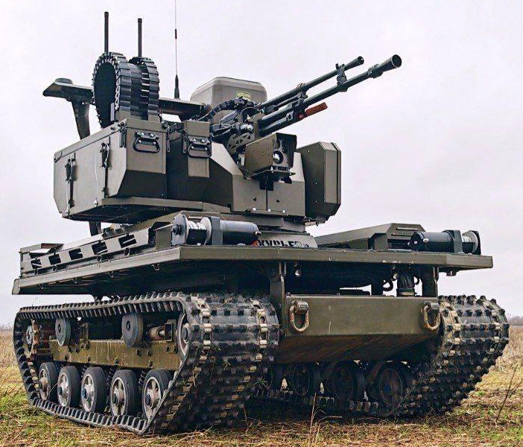
Welcome to GVSETS 2026
UGV mission set:
Reconnaissance
Casualty Evacuation
Resupply
Kamikaze
Direct Fire
Indirect Fire
Mine / Obstacle Laying
Mine / Obstacle Clearing
Bridging
Electronic Warfare
Directed Energy
Drone Mothership
Drone Interceptor
Combat Engineering

Slide 11
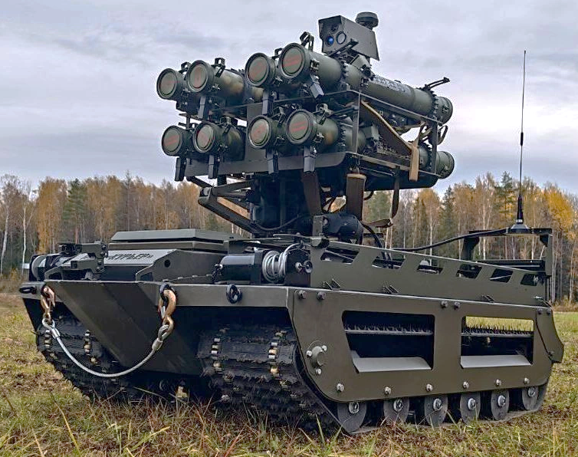
Welcome to GVSETS 2026
UGV mission set:
Reconnaissance
Casualty Evacuation
Resupply
Kamikaze
Direct Fire
Indirect Fire
Mine / Obstacle Laying
Mine / Obstacle Clearing
Bridging
Electronic Warfare
Directed Energy
Drone Mothership
Drone Interceptor
Combat Engineering

Slide 12
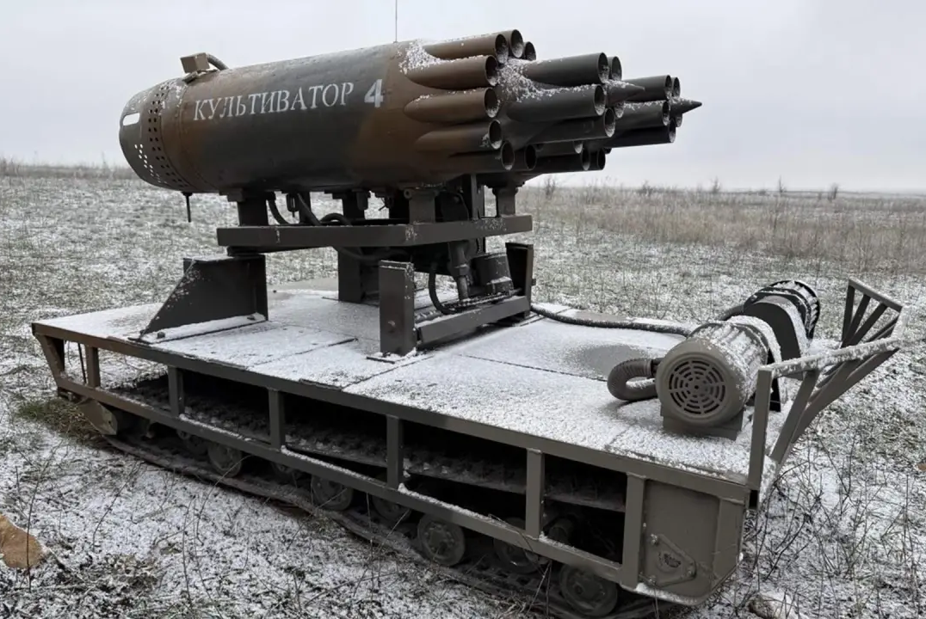
Welcome to GVSETS 2026
UGV mission set:
Reconnaissance
Casualty Evacuation
Resupply
Kamikaze
Direct Fire
Indirect Fire
Mine / Obstacle Laying
Mine / Obstacle Clearing
Bridging
Electronic Warfare
Directed Energy
Drone Mothership
Drone Interceptor
Combat Engineering

Slide 13
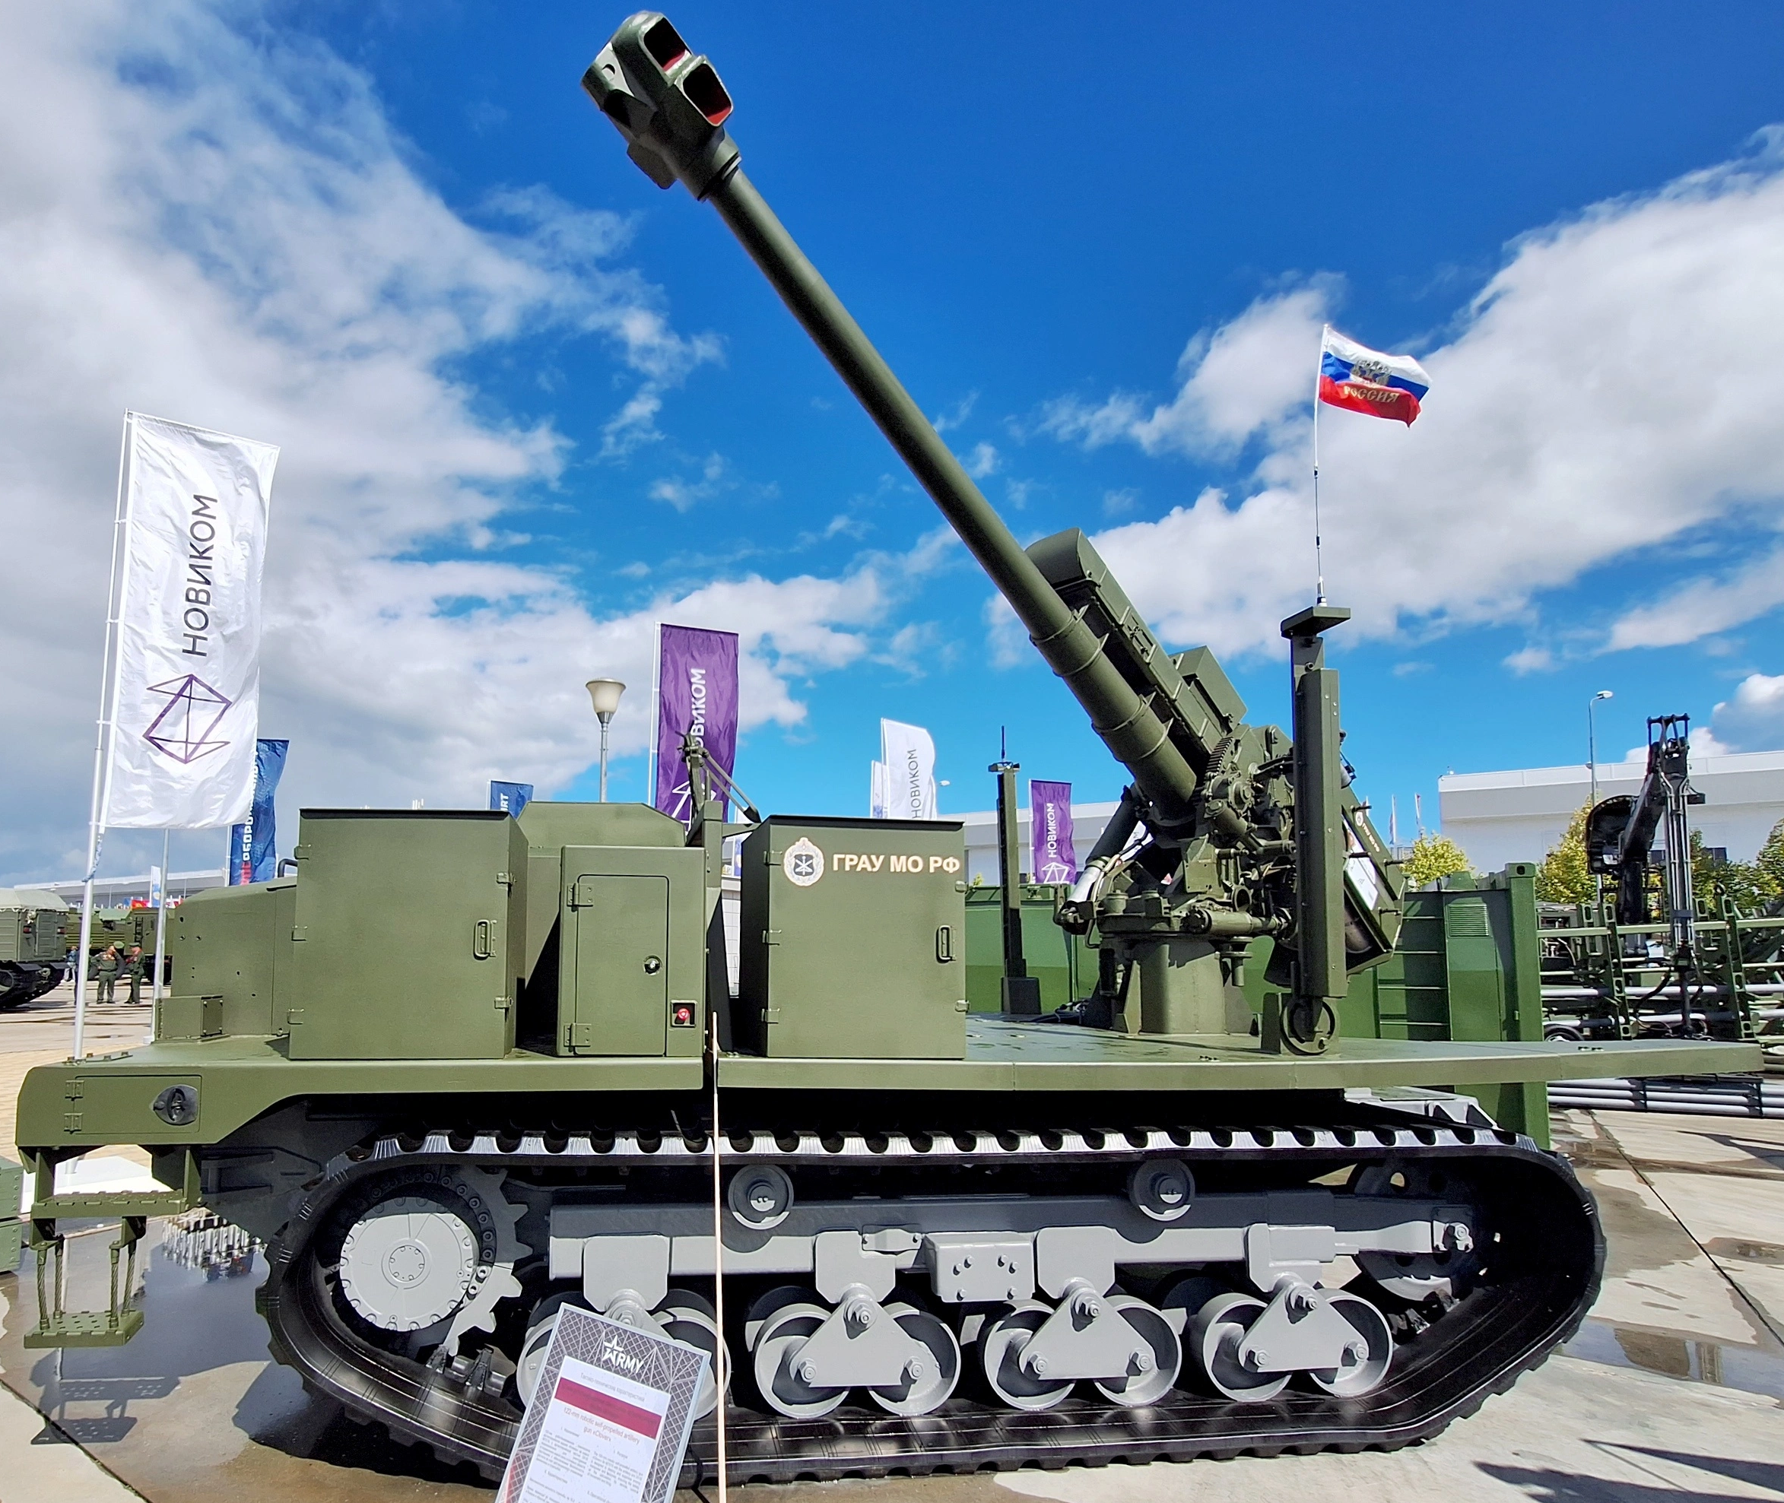
Welcome to GVSETS 2026
UGV mission set:
Reconnaissance
Casualty Evacuation
Resupply
Kamikaze
Direct Fire
Indirect Fire
Mine / Obstacle Laying
Mine / Obstacle Clearing
Bridging
Electronic Warfare
Directed Energy
Drone Mothership
Drone Interceptor
Combat Engineering

Slide 14
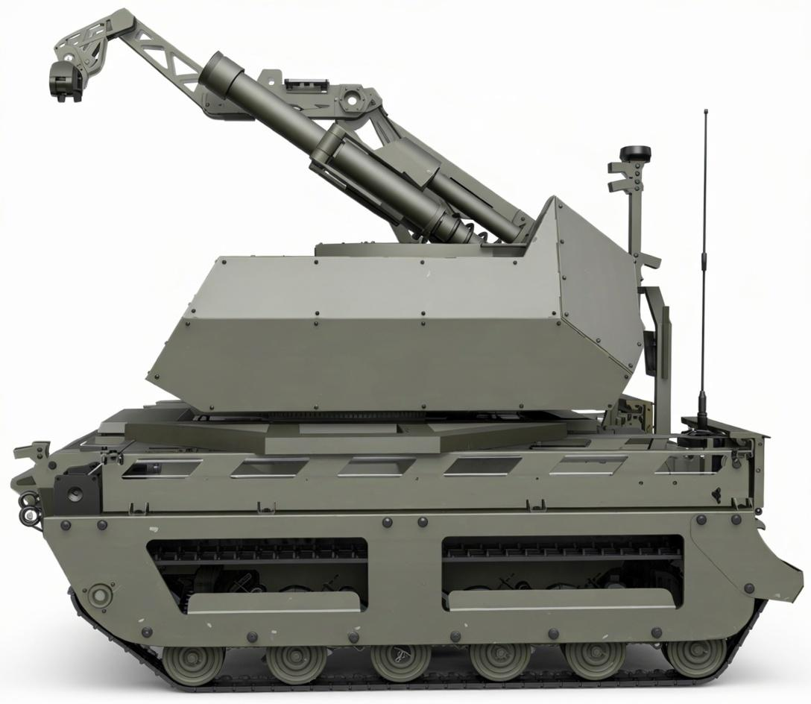
Welcome to GVSETS 2026
UGV mission set:
Reconnaissance
Casualty Evacuation
Resupply
Kamikaze
Direct Fire
Indirect Fire
Mine / Obstacle Laying
Mine / Obstacle Clearing
Bridging
Electronic Warfare
Directed Energy
Drone Mothership
Drone Interceptor
Combat Engineering

Slide 15
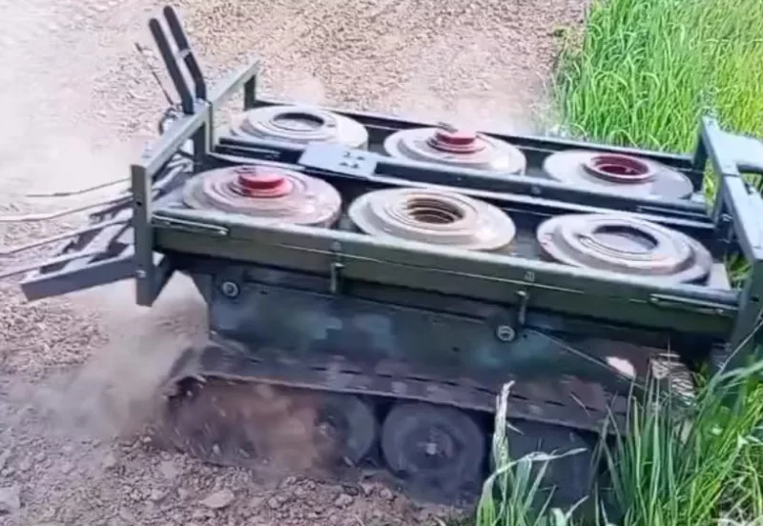
Welcome to GVSETS 2026
UGV mission set:
Reconnaissance
Casualty Evacuation
Resupply
Kamikaze
Direct Fire
Indirect Fire
Mine / Obstacle Laying
Mine / Obstacle Clearing
Bridging
Electronic Warfare
Directed Energy
Drone Mothership
Drone Interceptor
Combat Engineering

Slide 16
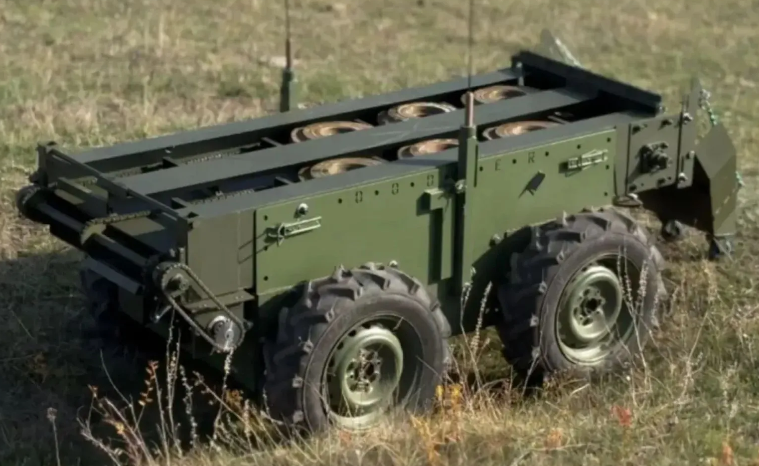
Welcome to GVSETS 2026
UGV mission set:
Reconnaissance
Casualty Evacuation
Resupply
Kamikaze
Direct Fire
Indirect Fire
Mine / Obstacle Laying
Mine / Obstacle Clearing
Bridging
Electronic Warfare
Directed Energy
Drone Mothership
Drone Interceptor
Combat Engineering

Slide 17
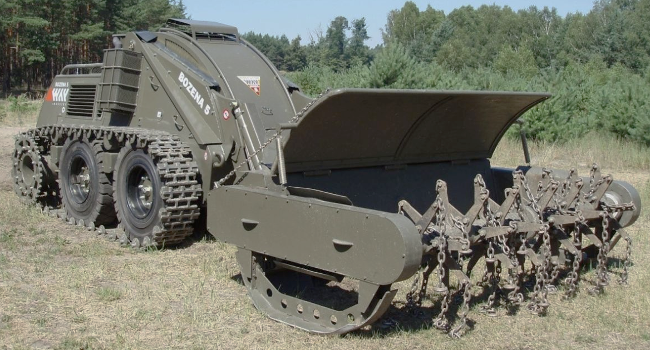
Welcome to GVSETS 2026
UGV mission set:
Reconnaissance
Casualty Evacuation
Resupply
Kamikaze
Direct Fire
Indirect Fire
Mine / Obstacle Laying
Mine / Obstacle Clearing
Bridging
Electronic Warfare
Directed Energy
Drone Mothership
Drone Interceptor
Combat Engineering

Slide 18
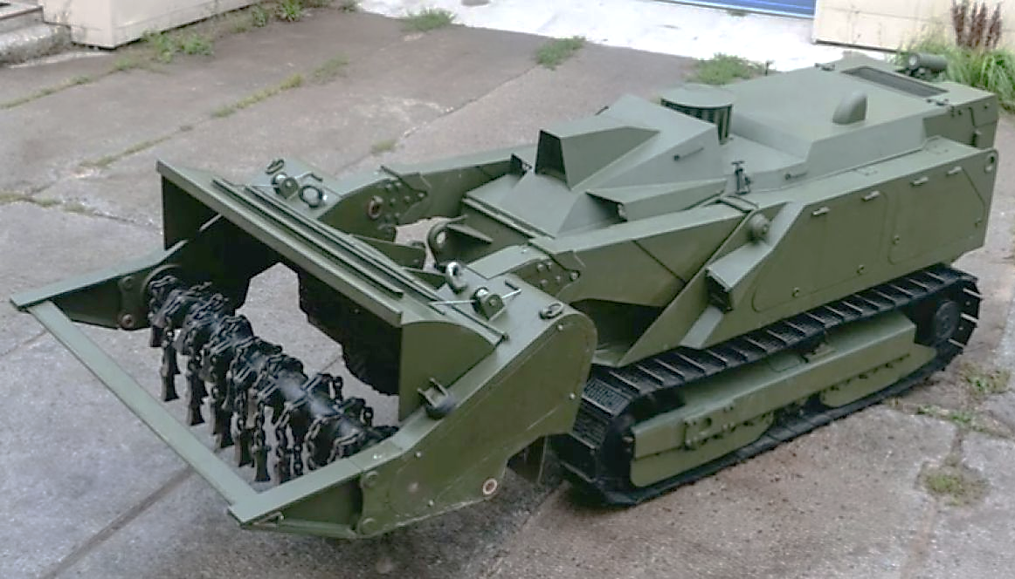
Welcome to GVSETS 2026
UGV mission set:
Reconnaissance
Casualty Evacuation
Resupply
Kamikaze
Direct Fire
Indirect Fire
Mine / Obstacle Laying
Mine / Obstacle Clearing
Bridging
Electronic Warfare
Directed Energy
Drone Mothership
Drone Interceptor
Combat Engineering

Slide 19
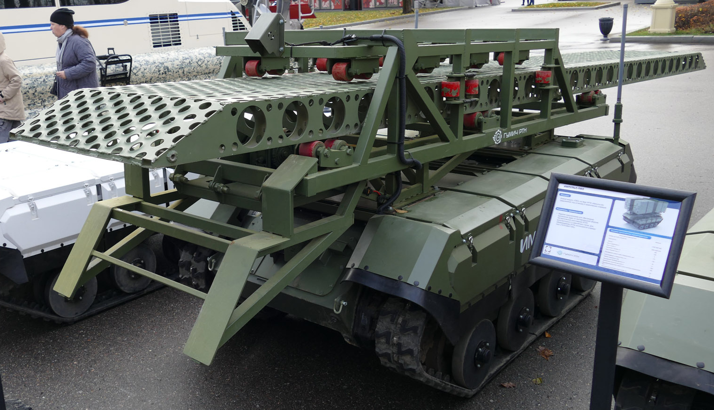
Welcome to GVSETS 2026
UGV mission set:
Reconnaissance
Casualty Evacuation
Resupply
Kamikaze
Direct Fire
Indirect Fire
Mine / Obstacle Laying
Mine / Obstacle Clearing
Bridging
Electronic Warfare
Directed Energy
Drone Mothership
Drone Interceptor
Combat Engineering

Slide 20
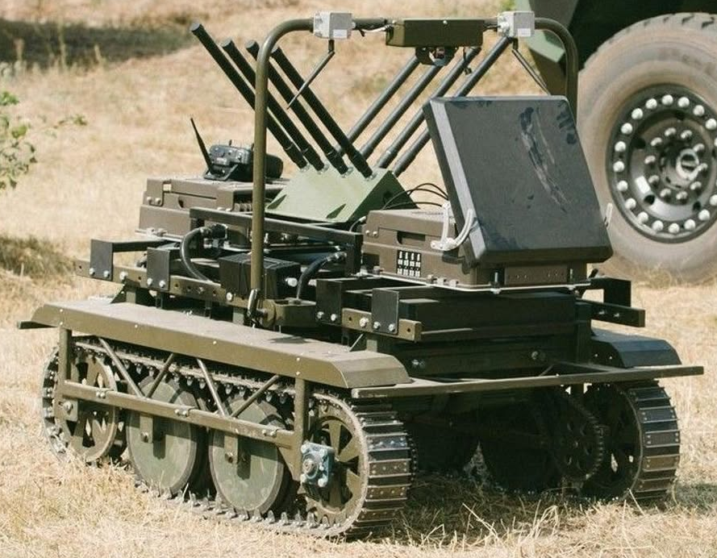
Welcome to GVSETS 2026
UGV mission set:
Reconnaissance
Casualty Evacuation
Resupply
Kamikaze
Direct Fire
Indirect Fire
Mine / Obstacle Laying
Mine / Obstacle Clearing
Bridging
Electronic Warfare
Directed Energy
Drone Mothership
Drone Interceptor
Combat Engineering

Slide 21
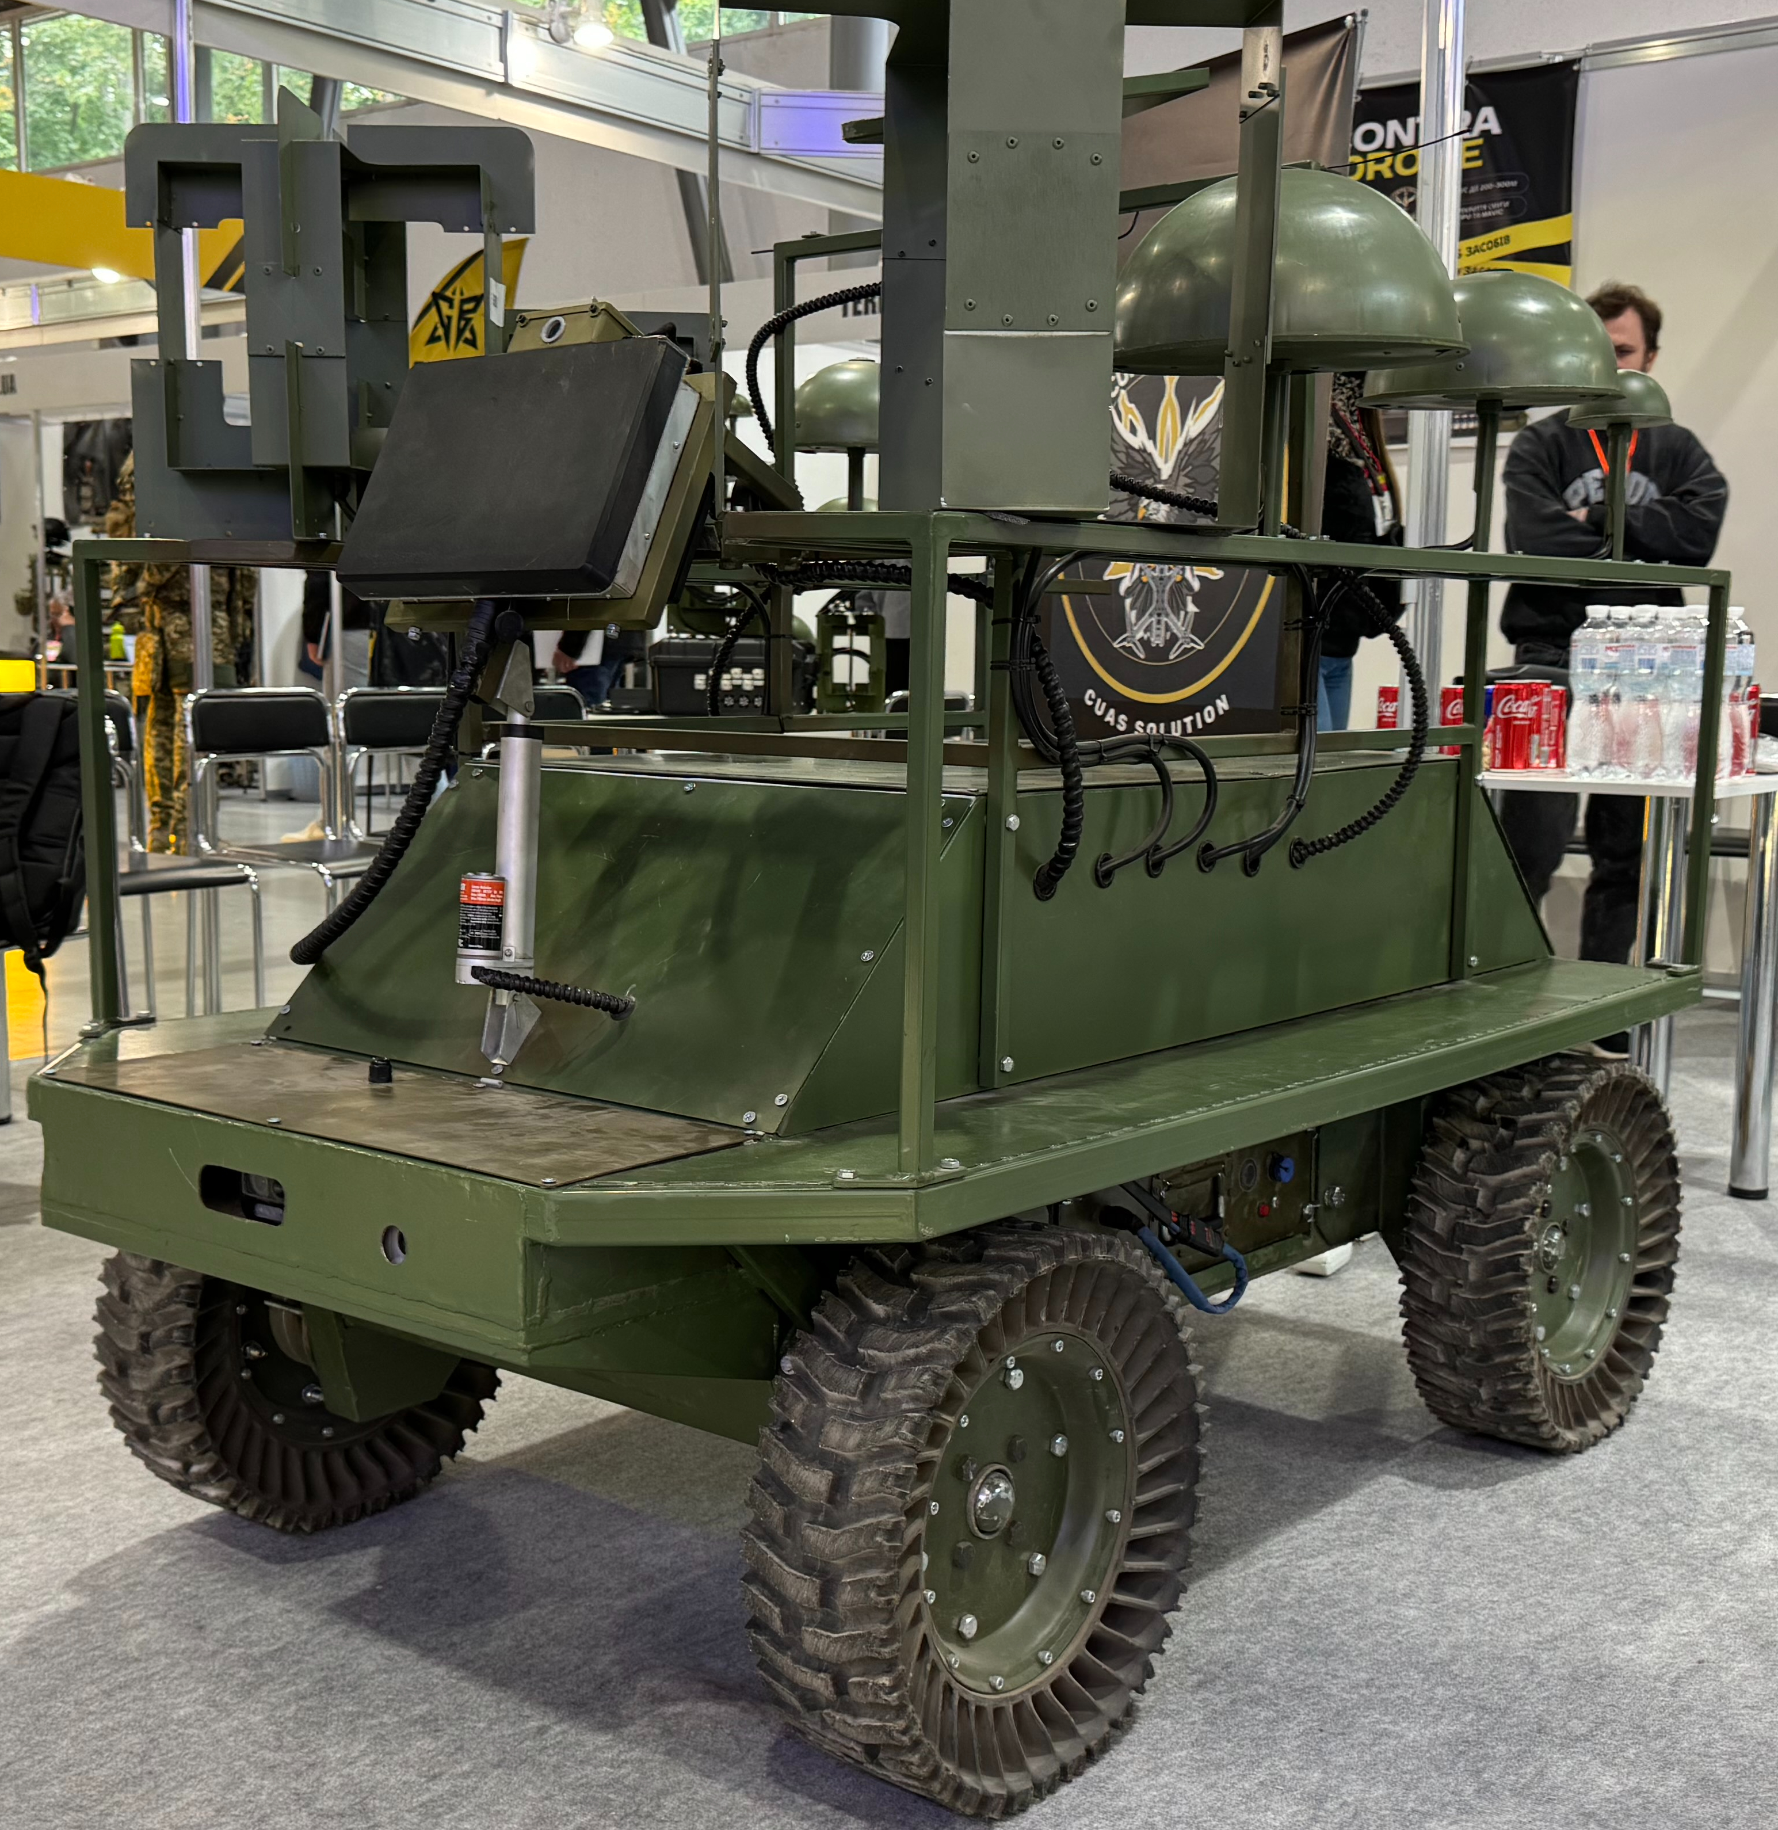
Welcome to GVSETS 2026
UGV mission set:
Reconnaissance
Casualty Evacuation
Resupply
Kamikaze
Direct Fire
Indirect Fire
Mine / Obstacle Laying
Mine / Obstacle Clearing
Bridging
Electronic Warfare
Directed Energy
Drone Mothership
Drone Interceptor
Combat Engineering

Slide 22
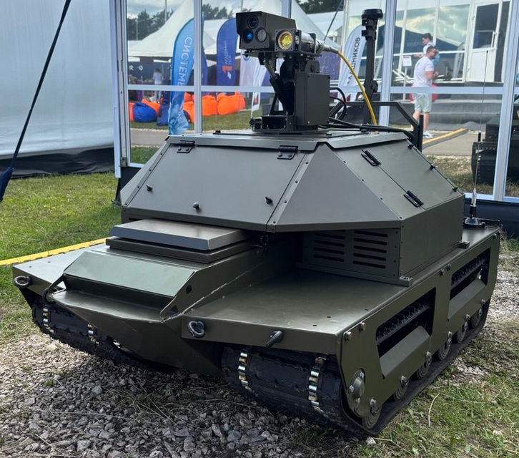
Welcome to GVSETS 2026
UGV mission set:
Reconnaissance
Casualty Evacuation
Resupply
Kamikaze
Direct Fire
Indirect Fire
Mine / Obstacle Laying
Mine / Obstacle Clearing
Bridging
Electronic Warfare
Directed Energy
Drone Mothership
Drone Interceptor
Combat Engineering

Slide 23
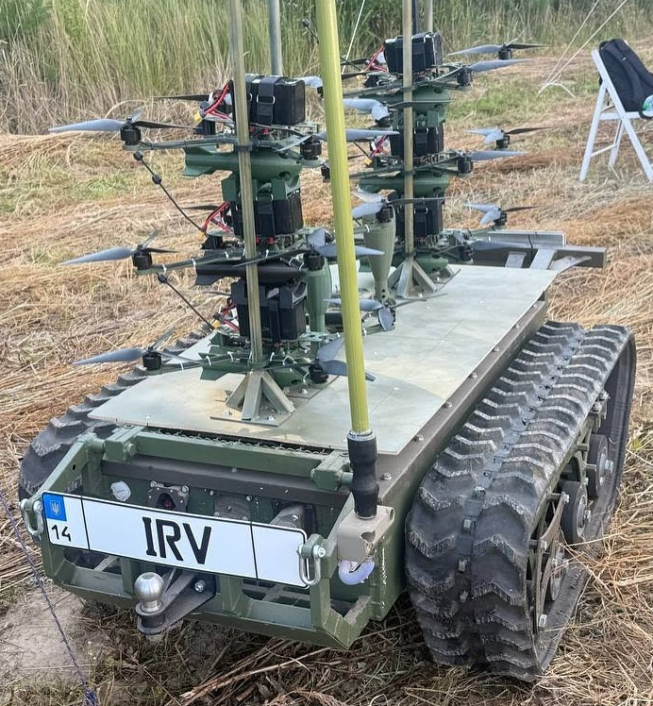
Welcome to GVSETS 2026
UGV mission set:
Reconnaissance
Casualty Evacuation
Resupply
Kamikaze
Direct Fire
Indirect Fire
Mine / Obstacle Laying
Mine / Obstacle Clearing
Bridging
Electronic Warfare
Directed Energy
Drone Mothership
Drone Interceptor
Combat Engineering

Slide 24
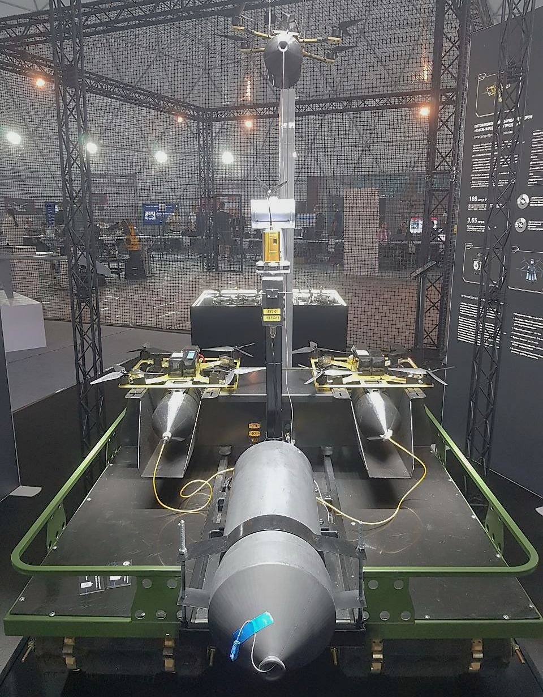
Welcome to GVSETS 2026
UGV mission set:
Reconnaissance
Casualty Evacuation
Resupply
Kamikaze
Direct Fire
Indirect Fire
Mine / Obstacle Laying
Mine / Obstacle Clearing
Bridging
Electronic Warfare
Directed Energy
Drone Mothership
Drone Interceptor
Combat Engineering

Slide 25
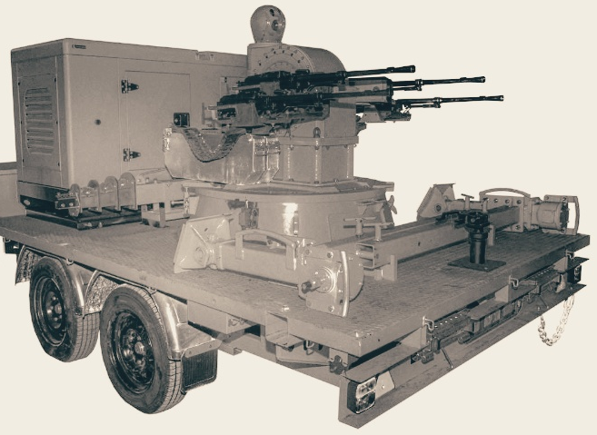
Welcome to GVSETS 2026
UGV mission set:
Reconnaissance
Casualty Evacuation
Resupply
Kamikaze
Direct Fire
Indirect Fire
Mine / Obstacle Laying
Mine / Obstacle Clearing
Bridging
Electronic Warfare
Directed Energy
Drone Mothership
Drone Interceptor
Combat Engineering

Slide 26
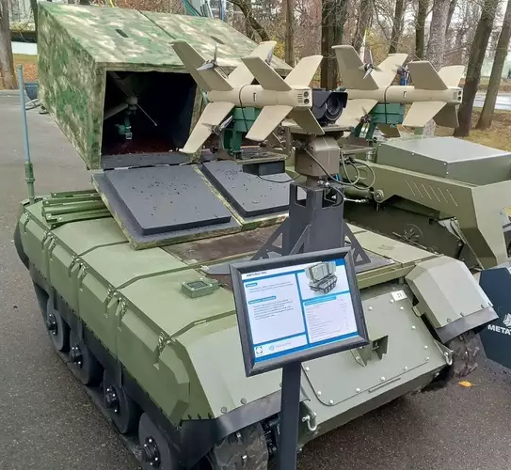
Welcome to GVSETS 2026
UGV mission set:
Reconnaissance
Casualty Evacuation
Resupply
Kamikaze
Direct Fire
Indirect Fire
Mine / Obstacle Laying
Mine / Obstacle Clearing
Bridging
Electronic Warfare
Directed Energy
Drone Mothership
Drone Interceptor
Combat Engineering

Slide 27
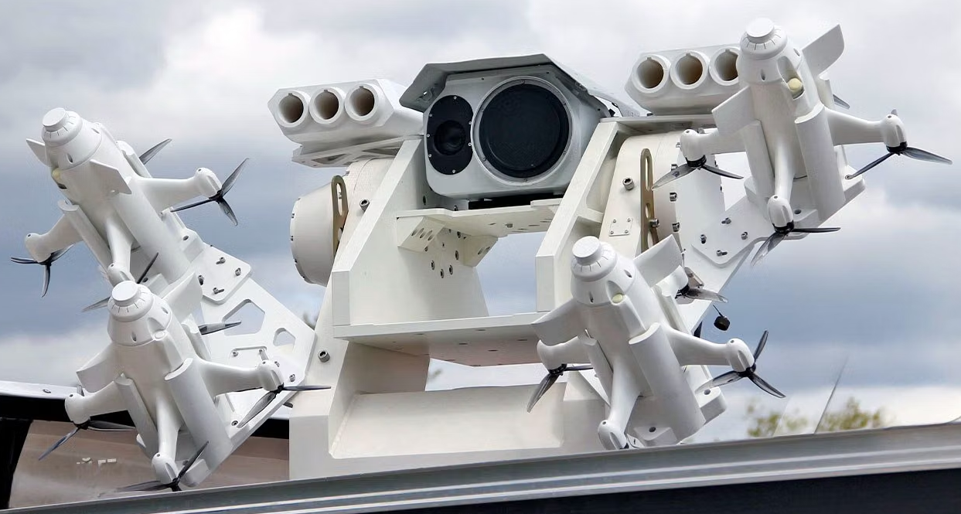
Welcome to GVSETS 2026
UGV mission set:
Reconnaissance
Casualty Evacuation
Resupply
Kamikaze
Direct Fire
Indirect Fire
Mine / Obstacle Laying
Mine / Obstacle Clearing
Bridging
Electronic Warfare
Directed Energy
Drone Mothership
Drone Interceptor
Combat Engineering

Slide 28
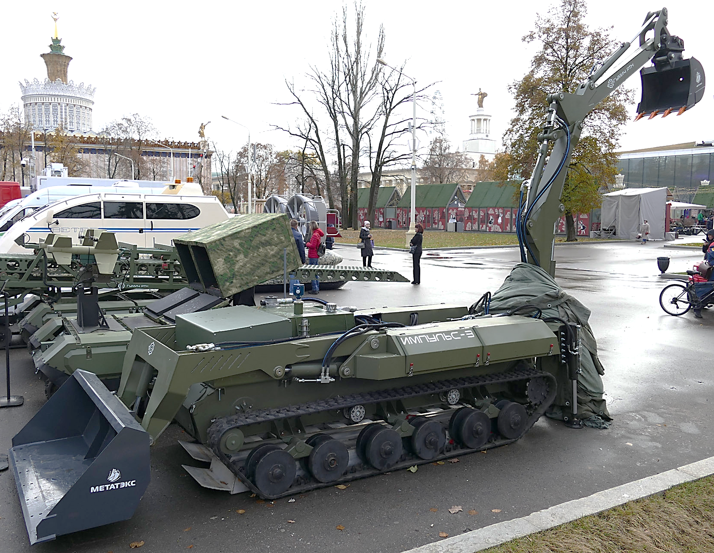
Welcome to GVSETS 2026
UGV mission set:
Reconnaissance
Casualty Evacuation
Resupply
Kamikaze
Direct Fire
Indirect Fire
Mine / Obstacle Laying
Mine / Obstacle Clearing
Bridging
Electronic Warfare
Directed Energy
Drone Mothership
Drone Interceptor
Combat Engineering

